Slide 1
Understanding Global Economic Trends: A Data-Driven Approach
Course Code: CSE3040 – EXPLORATORY DATA ANALYSIS
Winter Semester 2024–25
Team Name: Team B
Team Members:
- Madhu Saraswati Tammana (23MIA1003)
- Akshat Kumar (23MIA1110)
- Sanjay Chauhan (23MIA1124)

Slide 2
Abstract
This project explores global economic patterns through sectoral GDP analysis and advanced data mining techniques. By analyzing GDP data from 229 countries, we studied the contributions of agriculture, industry, and services. In addition to traditional EDA, we implemented outlier detection (Z-score, IQR, LOF) and Market Basket Analysis (Apriori, FP-Growth) to uncover hidden patterns in economic behavior.
These findings help assess alignment with SDG 8 – Decent Work and Economic Growth, and identify countries needing economic diversification or development support.

Slide 3
Objectives
Perform sector-wise EDA of GDP (Agriculture, Industry, Services).
Identify global economic disparities and patterns.
Detect anomalies and outliers in GDP structure using various techniques.
Apply Association Rule Mining using Apriori, Hashing, and FP-Growth.
Link findings with SDG 8 goals (sustainable and inclusive economic growth).

Slide 4

Proposed Methodology
1. Dataset Collection
2. Data Cleaning & Normalization
3. EDA (Univariate, Bivariate Analysis)
4. Outlier Detection (Z-score, IQR, LOF)
5. Association Rule Mining (Apriori, Hashing, FP-Growth)
6. Visualization & Result Interpretation
7. SDG 8 Alignment & Recommendations

Slide 5
Architecture
1. Dataset Collection
2. Data Cleaning & Normalization
3. EDA (Univariate, Bivariate Analysis)
4. Outlier Detection (Z-score, IQR, LOF)
5. Association Rule Mining (Apriori, Hashing, FP-Growth)
6. Visualization & Result Interpretation
7. SDG 8 Alignment & Recommendations

Slide 6
Dataset Overview
Dataset: List of Countries by GDP Sector Composition
Source: Kaggle
Link: https://www.kaggle.com/datasets/rajkumarpandey02/list-of-countries-by-gdp-sector-composition
Key Features:
- 229 countries
- GDP in USD
- % contributions from agriculture, industry, and services
- Ideal for sectoral, trend, and pattern mining analysis

Slide 7
Content
This dataset provides a snapshot of the global economy, broken down into three major sectors: Agriculture, Industry, and Services. It highlights the percentage each sector contributes to the total world GDP (Nominal) and gives the total production value for each sector.
Furthermore, for each sector, the dataset identifies the top contributing countries and their respective shares in the global output for that sector. This allows for a comparison of the economic strengths of different nations across these key areas.

Slide 8
SDG 8 – Decent Work and Economic Growth
Focus:
- Promote sustained, inclusive, and sustainable economic growth.
- Encourage productive employment and decent work for all.
Our data reveals:
- Countries over-dependent on agriculture face employment instability.
- Diversified economies (high industry + services) show resilience.
- Outlier detection and rule mining support identifying underperforming sectors.

Slide 9
Exploratory Data Analysis
Sectoral Dominance
-Most developed countries are services-driven (70–80%).
-Developing countries have agriculture-heavy economies.
Regional Disparities
- Africa: Agriculture > 25%
- Europe: Services dominate
- Asia: Industry-driven transitions (India, China)

Slide 10
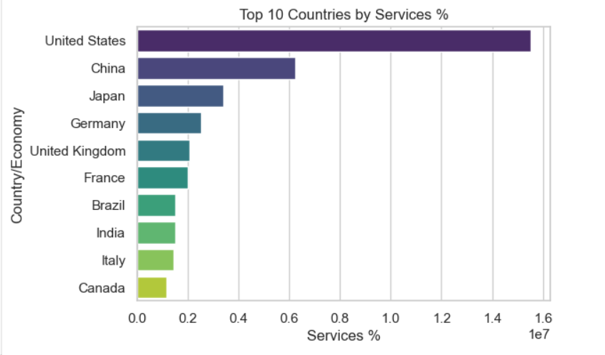
Visuals
Bar Plot: Top Countries by Services %
The bar plot highlights the top 10 countries with the highest percentage of their GDP attributed to the services sector. These countries are primarily developed economies, with advanced infrastructure and highly diversified economies. A larger services sector indicates a shift from manufacturing and agriculture-based industries to service-oriented industries such as finance, education, healthcare, and technology. The plot can help identify the global leaders in the services economy and reflect the broader economic development trends, showing how these countries have embraced services-driven growth.

Slide 11
Outlier and Anomaly Detection
Techniques Used:
Z-Score (for extreme values)
IQR (interquartile range)
Local Outlier Factor (LOF)
Key Findings:
- Chad, Afghanistan, and Ethiopia are outliers in agriculture share.
- High-income countries showed outliers in extremely low agriculture %.
- LOF detected hidden anomalies not visible in simple statistics.

Slide 12
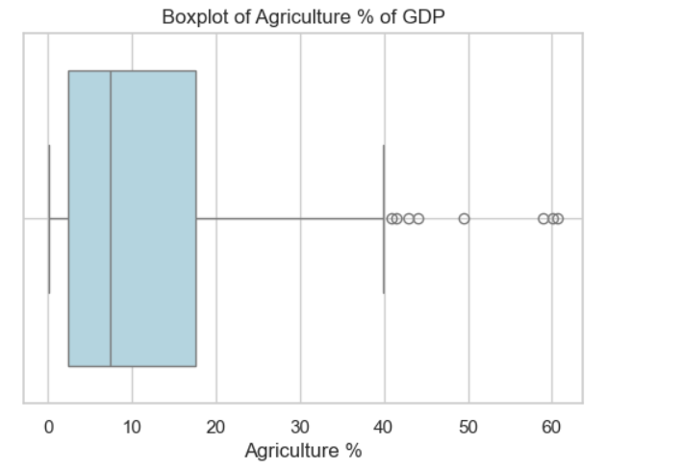
Visuals
Boxplot of Agriculture %
The boxplot of Agriculture % reveals the distribution of agriculture’s contribution to GDP across countries. The box represents the interquartile range (IQR), with the median shown inside the box. The whiskers extend to the minimum and maximum values, while outliers are marked individually. This visualization helps identify countries with extreme values in agricultural contribution, providing insights into the economic diversity across nations.

Slide 13
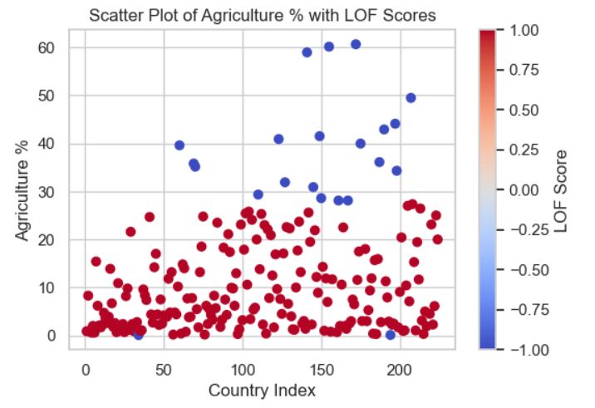
Visuals Contd.
Scatter Plot with LOF Scores
The scatter plot with LOF scores highlights the relationship between Agriculture % and the Local Outlier Factor. LOF identifies outliers based on the density of surrounding data points, with high LOF values indicating potential outliers. This plot helps to visually detect unusual agricultural GDP contributions that stand out from the rest of the data, allowing for further analysis of countries with atypical economic structures.

Slide 14
Association Rule Mining – Apriori & FP-Growth
Apriori Algorithm:
- Converted GDP % values to transaction-style bins (High/Med/Low).
- Discovered patterns like: "If Agriculture is High → Services is Low"
Hashing Improvement:
- Reduced candidate generation time using hashing-based pruning.
FP-Growth:
- Generated compact FP-Tree from frequent itemsets.
- Faster and more scalable for large rules.

Slide 15
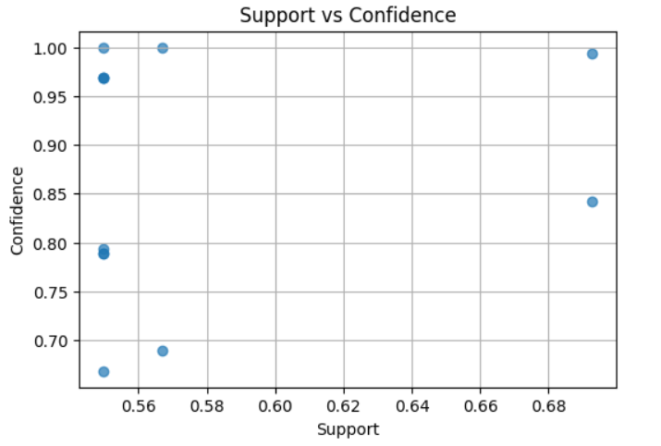
Visuals
Support vs Confidence Scatter Plot
The scatter plot illustrates the relationship between support and confidence for various association rules. Support indicates the frequency of itemsets, while confidence reflects the probability that an item will appear given another. High support and confidence generally suggest strong, reliable association rules, which are valuable for understanding customer purchasing patterns. The plot shows if rules with higher support also have high confidence or if low-support rules exhibit strong confidence, aiding in the selection of the most meaningful patterns.

Slide 16
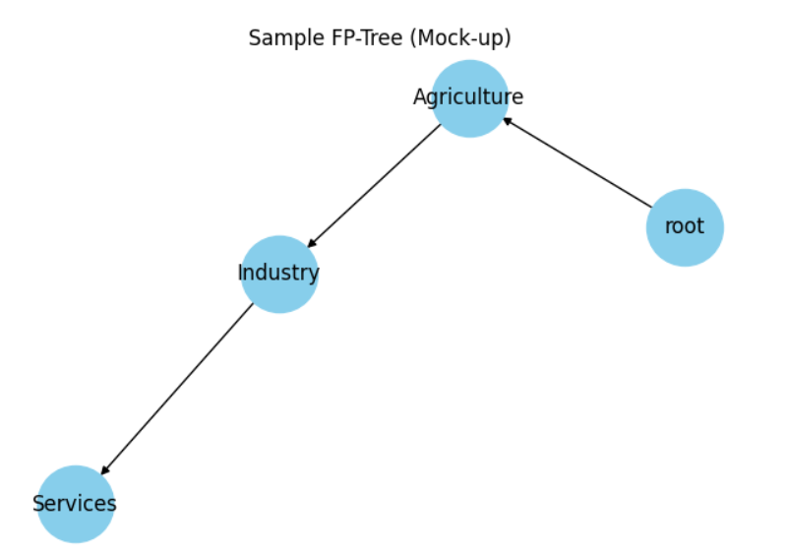
Visuals Contd.
Sample FP-Tree
The FP-Tree diagram represents frequent itemsets using a compact tree structure. Each path in the tree reflects a frequent itemset, with nodes representing items encountered often together. This visualization helps identify associations among items in the dataset, such as which items are often bought together. The tree structure is efficient for mining frequent itemsets and allows for fast extraction of patterns without the computational burden of candidate generation.

Slide 17

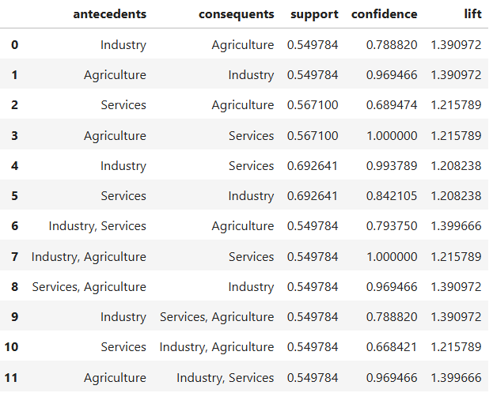
Association Rules Table
The association rules table presents the support, confidence, and lift values for each rule generated. Support measures the frequency of the itemsets, confidence shows the likelihood of an item being present when another is purchased, and lift indicates the strength of the relationship between the items. A higher lift suggests a stronger association, making the rules more valuable for decision-making in marketing or inventory management.

Slide 18
Key Results and Insights
1. Services dominate GDP in over 50% of countries — tied to higher GDP per capita.
2. 30+ countries are over-reliant on agriculture — higher risk of economic vulnerability.
3. Apriori rules suggest inverse relationship between high agriculture and services.
4. LOF helped detect hidden underperformers like Yemen, Burundi, and Laos.
5. FP-Growth showed faster performance and compact rule representation.

Slide 19
GitHub Repository
All code, notebooks, visualizations, and algorithm outputs are available here:
Link
https://github.com/akshat262005/EDA_SDG_8_Akshat

Slide 20
Conclusion
EDA revealed deep disparities in economic structures across regions.
Outlier detection highlighted vulnerable and non-diversified economies.
Association rule mining discovered hidden patterns between GDP sectors.
Apriori and FP-Growth offer insights for economic policy makers.
Our work supports SDG 8 by identifying where growth and decent work are most needed.

Slide 21
References
1. Kaggle Dataset: https://www.kaggle.com/datasets/rajkumarpandey02/list-of-countries-by-gdp-sector-composition
2. World Bank Data: https://databank.worldbank.org
3. Aurélien Géron – Hands-On EDA with Python
4. UN SDG 8 Report – www.un.org/sustainabledevelopment
5. Wes McKinney – Python for Data Analysis
6. Academic papers on Apriori, FP-Growth, and LOF from SpringerLink & IEEE Xplore

